Slide 1

Home Credit Default Risk
AML FINAL PROJECT
GROUP 09
INDIANA UNIVERSITY
May 2022

Slide 2




GROUP 09:
CHANDRA SAGAR BHOGADI
SRINIVAS VADDI
HANISH CHIDIPOTHU
NIDHI VRAJ

Slide 3
Contents:
Four P’s
PY Torch Deep Learning Models Classification
Conclusion and Further steps

Slide 4

Four P’s:
PAST
In the phase 1 using the logistic regression we performed EDA upon the data and gained a baseline model.
In the phase 2, we performed feature engineering , used different models and tuned the hyperparameters.
Finally, after a clear analysis check we justify that the Logistic regression and the ridge regression models are the best models
PRESENT
In the phase 3, we developed the PY Torch deep learning models. By, developing a Multi layer perceptron for binary classification and used tenser flow to visualize.

Slide 5
The reason for using the deep learning models is to improve the accuracy and AUC of the baseline model.
Finally, we submitted our scores and rank results in Kaggle
PLANNED
We implemented a new loss function in PY Torch
We plan on increasing the AUC score of the deep learning models using different methods.
PROBLEMS
The MLP(Multi-layer perceptron) didn’t function as expected

Slide 6
PY Torch Deep Learning Models: (classification)
Initially we developed a Multi-Layer perceptron for the binary classifications
The model uses the “ Sigmoid-activation function” and predicts the possibility of the class 1.
The model was fit for most of the data and the remaining is used for evaluation
We further implemented the stochastic gradient descent for exploiting the binary cross entropy loss as metric.
The MLP (Multi-layer perceptron did not go well for the regression model

Slide 7
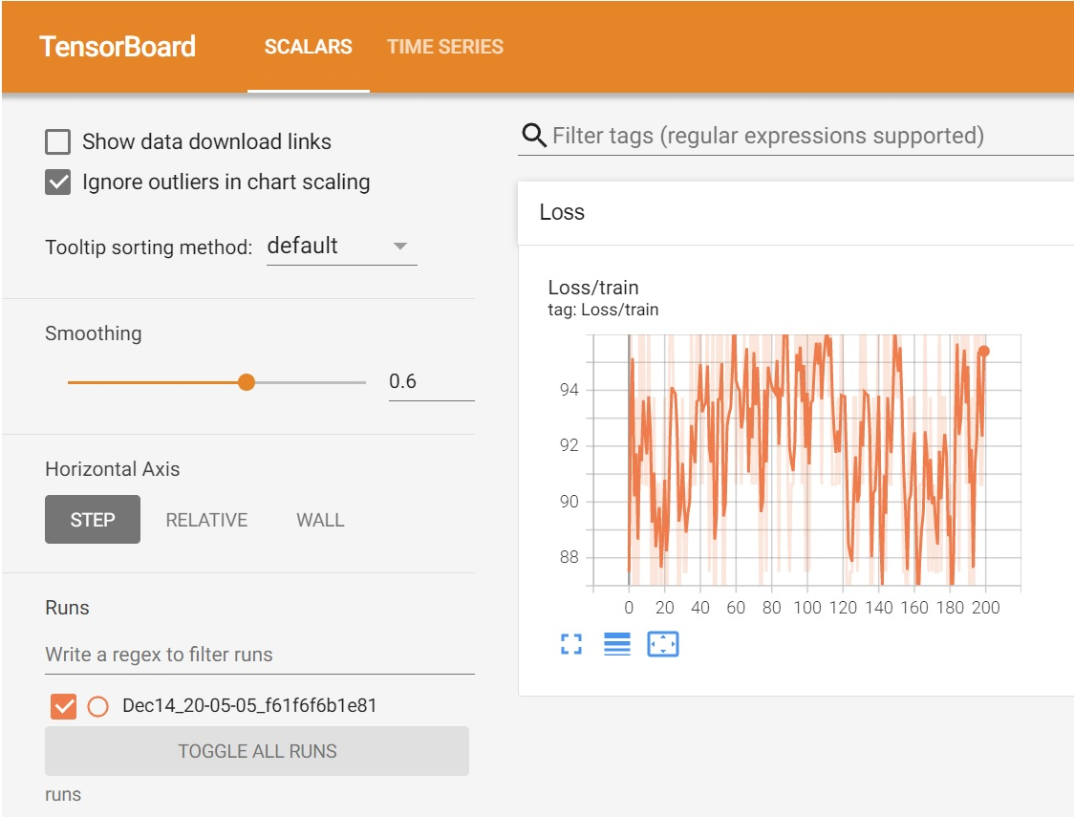
Tensor flow analysis:

Slide 8
Results & Discussions: The MPL classification Improved the the baseline test accuracy and AUC we used the feature engineer data for MLP
MODEL | TRAIN ACCURACY | TEST ACCURACY | TEST MSE | AUC
Baseline (Logistic Regression) | 91.5 | 91.8 | - | 0.501
Baseline with 79 Inputs | 91.5 | 91.7 | - | 0.505
Grid search Baseline with 79 inputs | 91.5 | 91.9 | - | 0.499
Decision Tree model | - | - | 7.54 | 0.731
Lasso Regression | - | - | 6.84 | 0.752
Ridge Regression | - | - | 6.85 | 0.755
MLP | - | 93 | - | 0.605

Slide 9

Conclusion & Further Steps:
In the following phase we implemented the deep learning models using PY Torch
The deep learning model improved the performance when compared to the classification model and a higher AUC value
Therefore, we chose the MLP classification and the ridge regression as our final best models
We can further implement and train using the Multi –Task deep learning model.

